Slide 1
What is TCP/IP?
Large collection of networking protocols and services
Two key protocols
  Transmission Control Protocol (TCP)
    Reliable delivery of messages
  Internet Protocol (IP)
    Manages the routing of network transmissions

Slide 2
The Origins and History of TCP/IP
1969
  Advanced Research Projects Agency (ARPA) funded research for packet-switched networking
  ARPANET
    Network built as a result of this project
In a packet-switched network
  Sender and receiver are identified by unique network addresses
  Packets are not required to follow the same path in transit

Slide 3
TCP/IP’s Design Goals
To withstand a potential nuclear strike
To permit different computer systems to communicate easily
To interconnect systems across long distances

Slide 4
TCP/IP Chronology
1978
  Internet Protocol version 4 (IPv4)
1983
  Defense Communications Agency took over operation of ARPANET
1986
  NSF launches high-speed network (NSFNET)
1987
  Number of hosts on the Internet breaks 10,000

Slide 5
TCP/IP Chronology (cont'd.)
1989
  Number of hosts on the Internet breaks 100,000
1990
  World Wide Web is born at Centre European Researche Nucleaire (CERN)
1991
  Commercial Internet Exchange (CIX) is formed
1992
  Internet Society (ISOC) is chartered

Slide 6
TCP/IP Chronology (cont'd.)
1993
  InterNIC is chartered
1994
  Online junk mail begins to proliferate
1995
  Netscape launches Netscape Navigator
1996
  Microsoft launches Internet Explorer Web browser
1997
  31 million registered domain names

Slide 7
TCP/IP Chronology (cont'd.)
2000
  Love Letter worm infects over one million PCs
2001
  Number of hosts on the Internet breaks 150 million
  Sircam virus and Code Red worm infect thousands
2002
  204 million Internet hosts
2003
  Public Interest Registry becomes .org registry operator

Slide 8
TCP/IP Chronology (cont'd.)
2005
  Number of hosts on the Internet breaks 250 million
2008
  Number of hosts on the Internet breaks 600 million
2009
  Number of hosts on the Internet breaks one billion
  Number of Chinese users surpasses the number of U.S. users

Slide 9
Who “Owns” TCP/IP?
TCP/IP
  Falls squarely into the public domain
  Funded with public monies since its inception
  Owned by everybody and nobody

Slide 10
Standards Groups That Oversee TCP/IP
Internet Society (ISOC)
Internet Architecture Board (IAB)
Internet Engineering Task Force (IETF)
Internet Research Task Force (IRTF)
Internet Corporation for Assigned Names and Numbers (ICANN)

Slide 11
IPv4 and IPv6
IPv4
  Established mid- to late-1980s
  Uses 32-bit addresses (around four billion distinct network addresses)
  Entire address space now occupied
IPv6
  Supports 128-bit addresses
  Address space roughly 8 * 1028 larger than IPv4 space

Slide 12
TCP/IP Standards and RFCs
Request For Comments (RFCs)
  Provide documentation to understand, implement, and use TCP/IP protocols
Index for all RFCs available at:
  www.faqs.org/rfcs/
RFC 2026
  Describes how a RFC is created

Slide 13
OSI Reference Model Overview
OSI reference model
  A network reference model
  Formally known as ISO/OSI (International Standards Organization) / (Open System Interconnection)
  Designed to replace TCP/IP
  Standard way to explain how networks operate
  TCP/IP is the open standard protocol suite of choice

Slide 14
Breaking Networking into Layers
Divide and conquer approach
  Separates networking hardware concerns from those related to networking software
Key points about networking
  Easier to solve problems when broken into series of smaller problems
  Layers operate independently of one another
  Changes to one layer need not affect other layers

Slide 15
Models Break Networking into Layers (cont'd.)
Key points about networking
  Individual layers work together on pairs of computers
  Different expertise is needed at each layer
  Layers in a network implementation work together to create a general solution
  Network protocols usually map into one or more layers
  TCP/IP is designed around a layered model

Slide 16
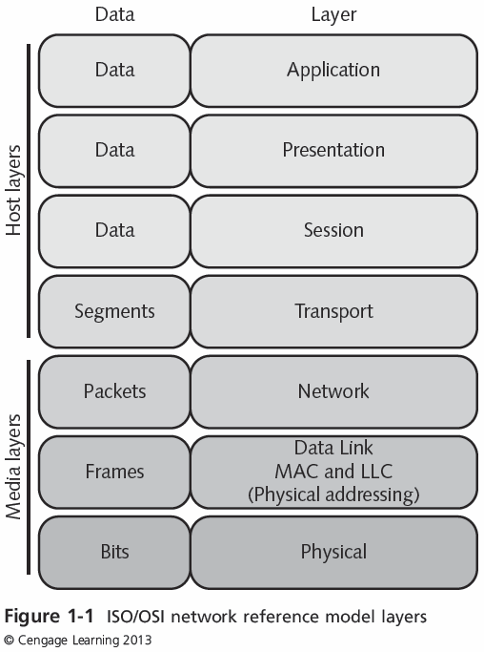
The ISO/OSI Network Reference Model Layers

Slide 17
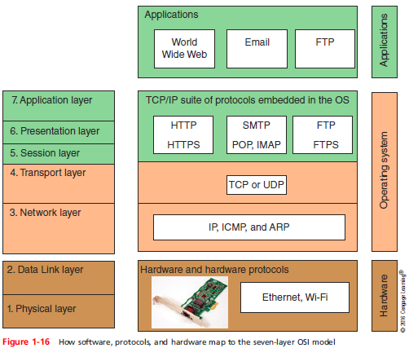
7 Layer OSI model
Introducing TCP/IP

Slide 18
How Protocol Layers Behave
Layers
  Exist to encapsulate or isolate specific types of functionality
  Provide services to the layer above
  Deliver data to or accept data from the layer below
Protocol Data Units (PDUs)
  Include “envelope information” in the form of specific headers and trailers

Slide 19
Physical Layer
Includes the physical transmission medium
Job is to activate, maintain, and deactivate network connections
Manages communications with the network medium going down the protocol stack
Handles conversion of outgoing data

Slide 20
Data Link Layer
Situated between the Physical layer and the Network layer in the reference model
Job is to
  Enable reliable transmission of data through the Physical layer at the sending end
  Check reliability at the receiving end
Manages point-to-point transmission across the networking medium

Slide 21
Network Layer
Handles logical addresses associated with individual machines on a network
Uses addressing information to
  Determine how to send a PDU
Embodies notion of multiple simultaneous connections between different IP addresses
Flexible enough to
  Recognize and use multiple routes between a sender and a receiver

Slide 22
Transport Layer
Ensures reliable end-to-end transmission of PDUs
Includes end-to-end error-detection and error-recovery
Segmentation
  Involves cutting up a big message into a numbered sequence of chunks, called segments
PDUs used at the Transport layer are called segments, or data segments

Slide 23
Session Layer
Defines mechanisms to:
  Permit senders and receivers to request that a conversation start or stop
  Keep a conversation going even when traffic may not otherwise flow between the parties involved
Checkpoints
  Define the last point up to which successful communications are known to have occurred

Slide 24
Presentation Layer
Handles transforming data from:
  Generic, network-oriented forms of expression to more specific, platform-oriented forms of expression
A redirector or network shell
  Special computer facility that resides here
Can supply special data-handling functions for applications

Slide 25
Application Layer
Defines an interface that applications can use to request network services
Defines a set of access controls over the network
PDUs
  Generically called Application PDUs

Slide 26
TCP/IP Transport Layer Protocols
Two TCP/IP Transport layer protocols
  The transmission Control Protocol (TCP)
    Connection-oriented
  The User Datagram Protocol (UDP)
    Connectionless
UDP
  Transmits data in a “best-effort delivery”
  Does no follow-up checking on its receipt

Slide 27
TCP/IP Application Layer
Also known as the Process layer
TCP/IP services depend on:
  Special “listener process,” called a daemon
    Operates on a server to handle incoming user requests for specific services
  Each TCP/IP service has an associated port address

Slide 28
TCP/IP Protocols, Services, Sockets, And Ports
Multiplexing
  Combining various sources of outgoing data into a single output data stream
Demultiplexing
  Breaking up an incoming data stream so separate portions may be delivered to the correct applications
Well-known protocols
  Assign a series of numbers to represent a sizable collection of TCP/IP-based network services

Slide 29
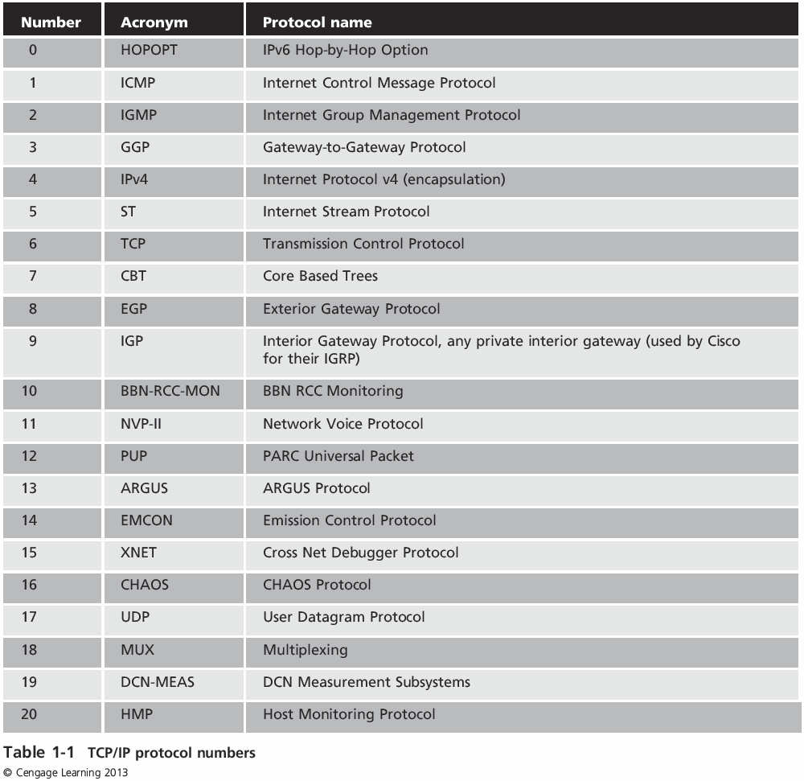
TCP/IP Protocol Numbers

Slide 30
TCP/IP Port Numbers
TCP/IP application processes
  Sometimes called network services
  Identified by port numbers
Source port number
  Identifies the process that sent the data
Destination port number
  Identifies the process to receive that data

Slide 31
TCP/IP Sockets
Well-known or registered ports (0 – 1023)
  Represent preassigned port numbers
  Registered port numbers (1024 – 49151)
  Private port numbers (49152 – 65535)
Socket address (or socket)
  The combination of a particular IP address and a dynamically assigned port address

Slide 32
Data Encapsulation In TCP/IP
At each layer in the TCP/IP protocol stack
  Outgoing data is packaged and identified for delivery to the layer underneath
Header (or packet header)
  PDU’s own particular opening component
  Identifies the protocol in use, the sender, and the intended recipient
Trailer (or packet trailer)
  Provides data integrity checks for the payload

Slide 33
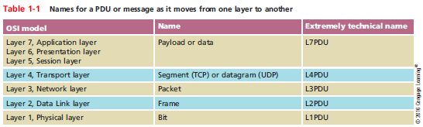
PDU names throughout the layers
Introducing TCP/IP

Slide 34
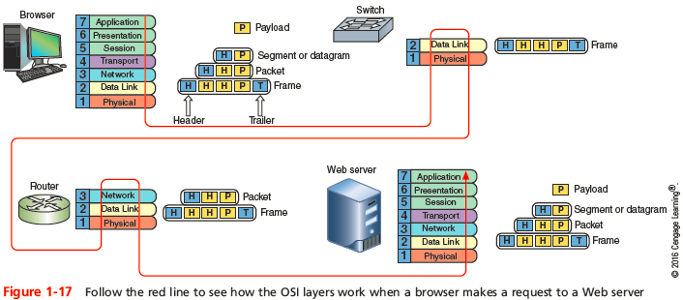
How layers work together
Introducing TCP/IP

Slide 35
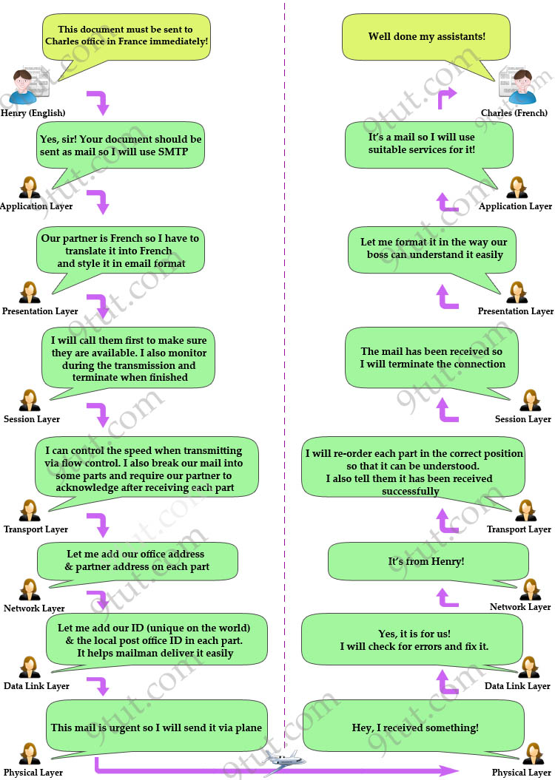

Slide 36
IP Addressing Basics
Computers deal with network addresses as bit patterns
IP uses a three-part addressing scheme
  Symbolic
    Example “support.dell.com”
  Logical numeric
    Example 172.16.1.10
  Physical numeric
    Six-byte numeric address, burned into firmware (on a chip) by network interface manufacturers
© 2013 Course Technology/Cengage Learning. All Rights Reserved.

Slide 37
IP Addressing Basics (cont'd.)
Address Resolution Protocol (ARP)
  Permits computers to translate numeric IP addresses to MAC layer addresses
ReverseARP (RARP)
  Translates MAC layer addresses into numeric IP addresses
© 2013 Course Technology/Cengage Learning. All Rights Reserved.

Slide 38
IPv4 Addressing
Numeric IPv4 addresses
  Dotted decimal notation
  Take the form n.n.n.n, where n is guaranteed to be between 0 and 255
  Each number is an 8-bit number called an octet
  Duplication is not allowed
© 2013 Course Technology/Cengage Learning. All Rights Reserved.

Slide 39
IPv4 Address Classes
IP addresses
  Subdivided into five classes: Class A to Class E
For first three classes octets are divided as follows
  Class A n. h.h.h
  Class B n.n. h.h
  Class C n.n.n. h
    n = network, h = host
© 2013 Course Technology/Cengage Learning. All Rights Reserved.

Slide 40
IP Address Classes (cont'd.)
Address Classes D and E are for special uses
  Class D addresses
    Multicast communications
  Class E addresses
    Reserved entirely for experimental use
© 2013 Course Technology/Cengage Learning. All Rights Reserved.

Slide 41
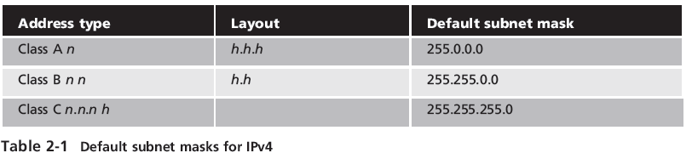
IPv4 Networks and Subnets Masks
Subnet mask
  Special bit pattern that “blocks off ” the network portion of an IP address with an all-ones pattern
Default masks for Classes A, B, and C
© 2013 Course Technology/Cengage Learning. All Rights Reserved.

Slide 42
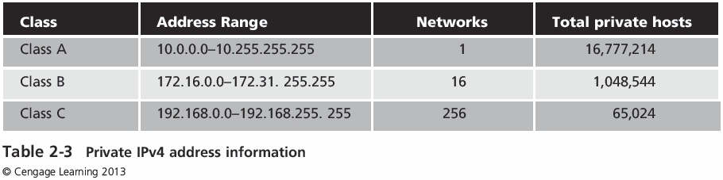
Public Versus Private IPv4 Addresses (cont’d.)
© 2013 Course Technology/Cengage Learning. All Rights Reserved.

Slide 43
The End of the IPv4 Address Space
Address space saving techniques
  Classless Inter-Domain Routing (CIDR)
  Trade in existing IP network addresses
  RFC 1918
    Reserves three ranges of IP addresses for private use
  Network Address Translation (NAT)
    Lets networks use private IP addresses internally and maps them to public IP address externally
© 2013 Course Technology/Cengage Learning. All Rights Reserved.

Slide 44
Protocol Multiplexing
Layered architecture allows Multiplexing by it nature
Different protocols can coexist on the same system!
Layers above the NETWORK layer use end-to-end protocols thus inly exist on the end systems
Network layer provides hop-by-hop protocol and is used on the end systems and all intermediate systems as well
Introducing TCP/IP

Slide 45
Protocol Multiplexing
Router – has two or more network interfaces and is termed MULTIHOMED
Forwarding – when a destination address is used to determine where each datagram should be sent
Introducing TCP/IP

Slide 46
Introducing IPv6
IPv6
  Provides a vast abundance of IP addresses and better management of its address space
  Eliminates the need for NAT
  Has modernized routing support and natively allows for expansion along with the growing Internet
  Supports network security by using authentication and encryption extension headers
© 2013 Course Technology/Cengage Learning. All Rights Reserved.

Slide 47
Introducing IPv6
IPv6
Has 340 undecillion addresses which represents 10 nonillion addresses per person on the earth!!!!
That is 10,000,000,000,000,000,000,000,000,000,000 IP addresses per person!
© 2013 Course Technology/Cengage Learning. All Rights Reserved.

Slide 48
Introducing IPv6
IPv6 is not just about more addresses:
  Stateless autoconfiguration
  End-to-end reachability without private addresses and NAT
  Better support for mobility
  Peer-to-peer networking easier to create and maintain, and services such as VoIP and Quality of Service (QoS) become more robust.
© 2013 Course Technology/Cengage Learning. All Rights Reserved.

Slide 49
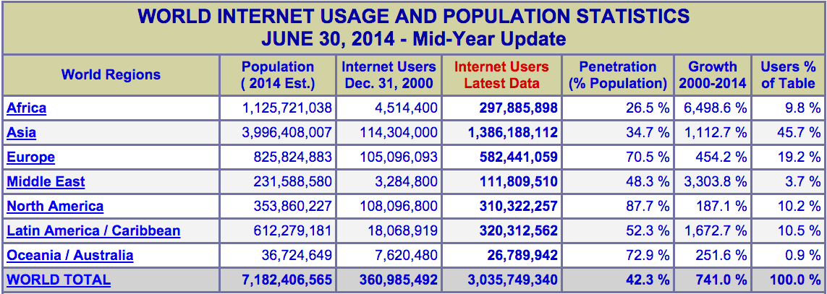
Running out of IPv4
The locations with the largest populations have the lowest percentage of people connected to the Internet. See the problem?

Slide 50
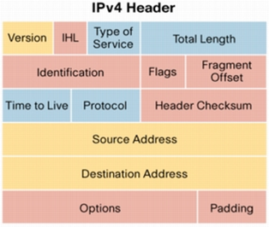
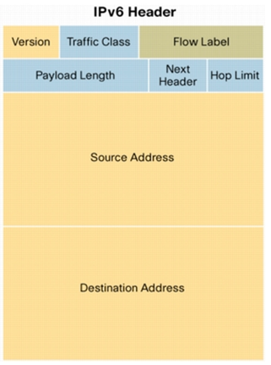
Introducing IPv6
© 2013 Course Technology/Cengage Learning. All Rights Reserved.

Slide 51
IPv6 Addressing
IPv6 addresses
  128 bits long
  String that uniquely identifies one single network interface on the global Internet
  Contains a network portion and a host portion
  Network and host portion depend on who’s looking at it and where they are located
© 2013 Course Technology/Cengage Learning. All Rights Reserved.

Slide 52
Address Format and Notation
Addresses in IPv6 are also binary numbers
Expressed using hexadecimal notation (00–FF)
Broken up differently
  IPv6 uses groups of four 16-bit numbers called “words,” separated by a colon character (:)
Examples:
  1090:0000:0000:0000:0009:0900:210D:325F or
  1090::9:900:210D:325F
© 2013 Course Technology/Cengage Learning. All Rights Reserved.

Slide 53
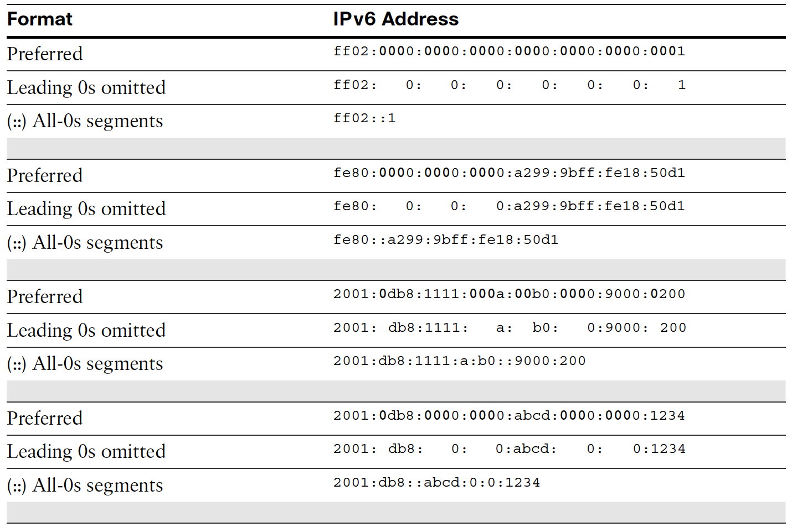

Slide 54
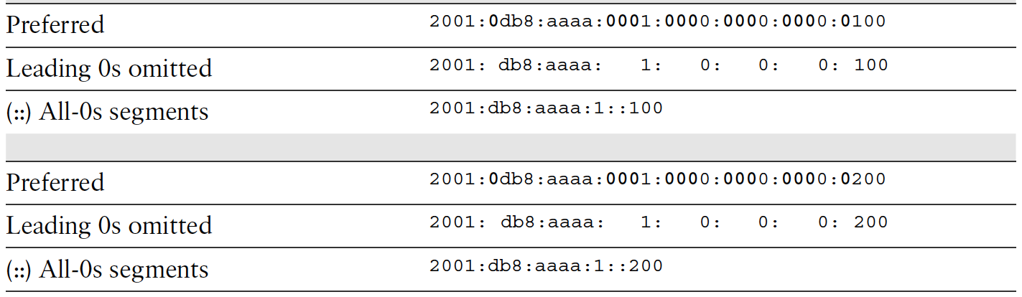

Slide 55
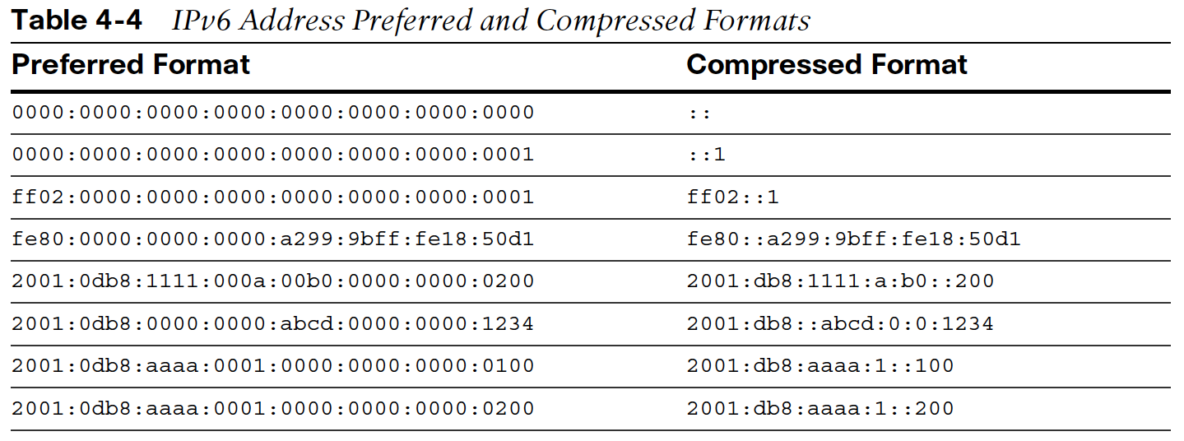

Slide 56
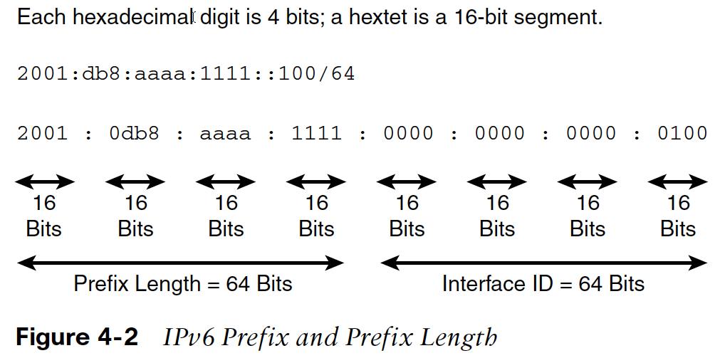

Slide 57
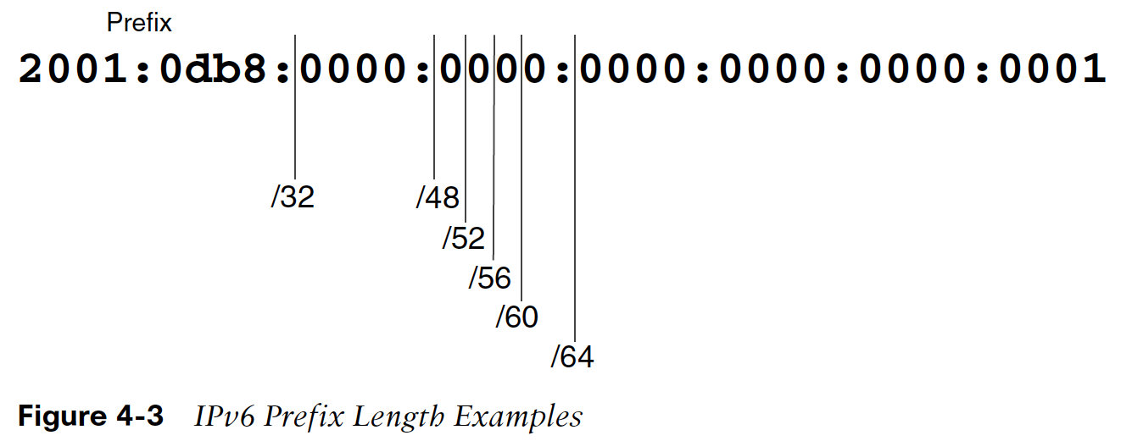

Slide 58
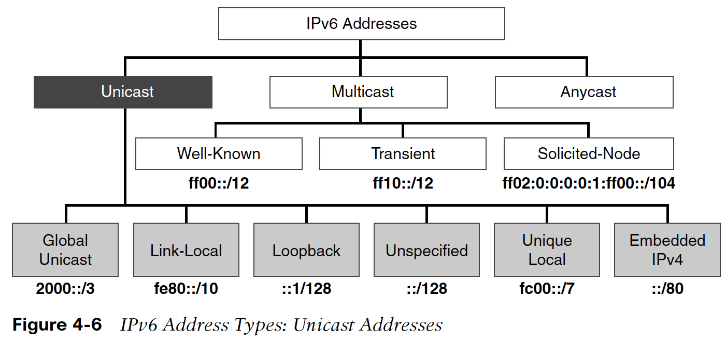

Slide 59
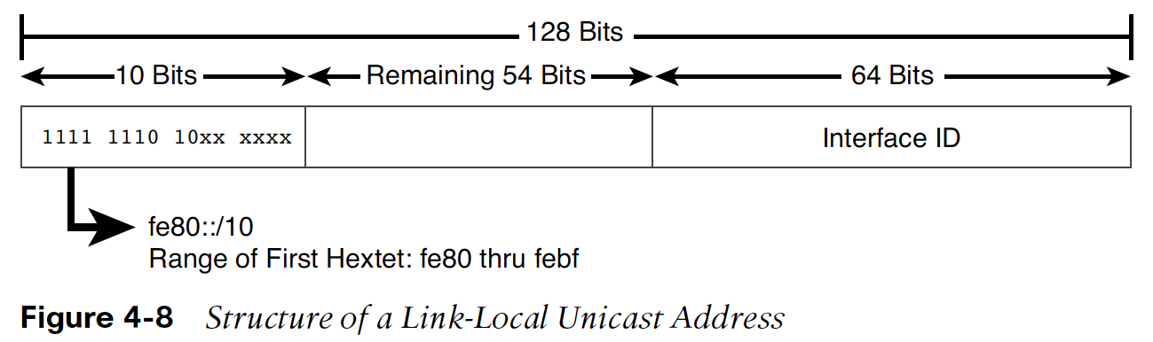

Slide 60
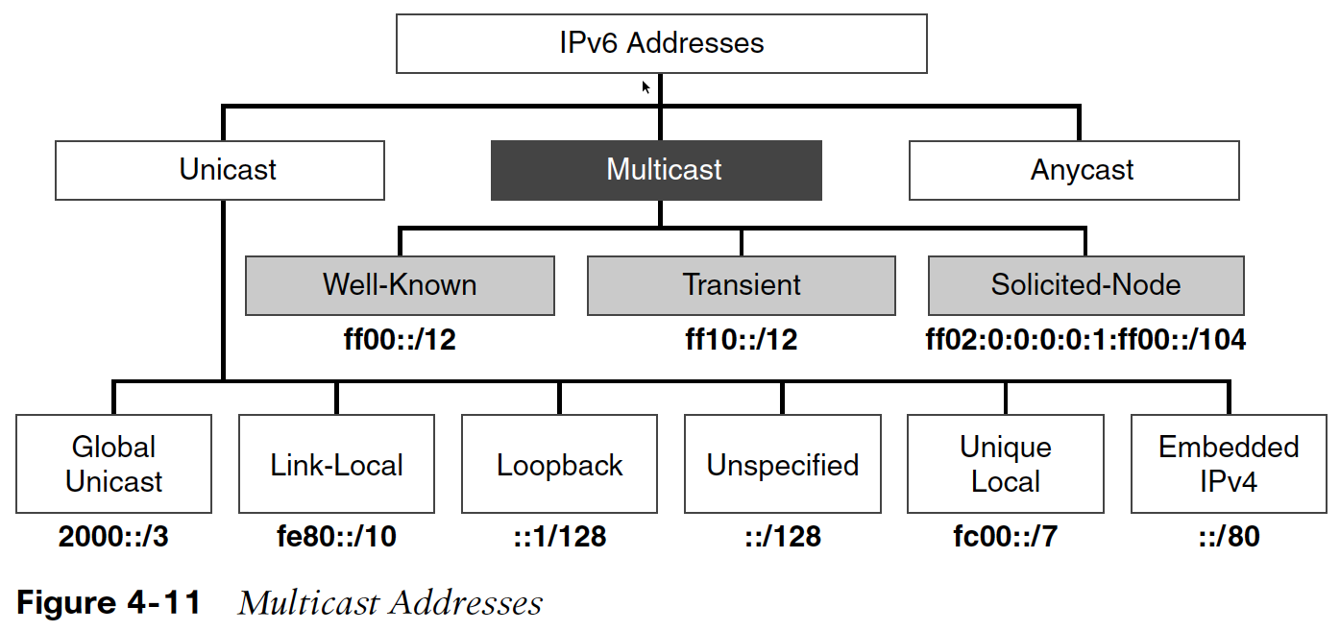

Slide 61
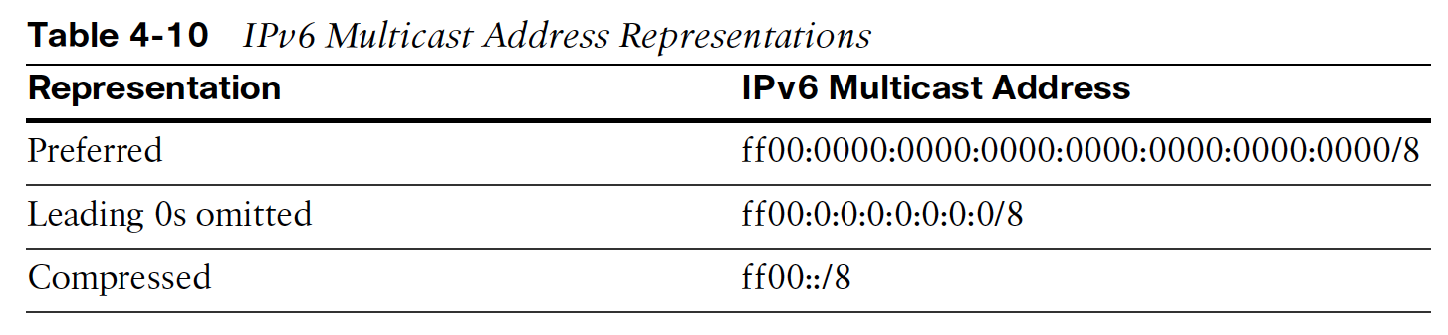

Slide 62
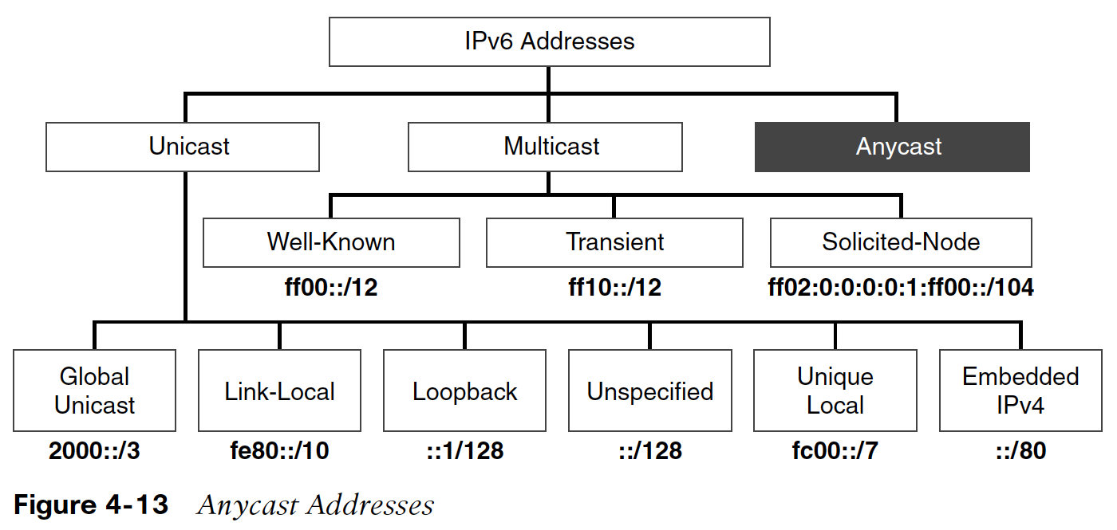

Slide 63
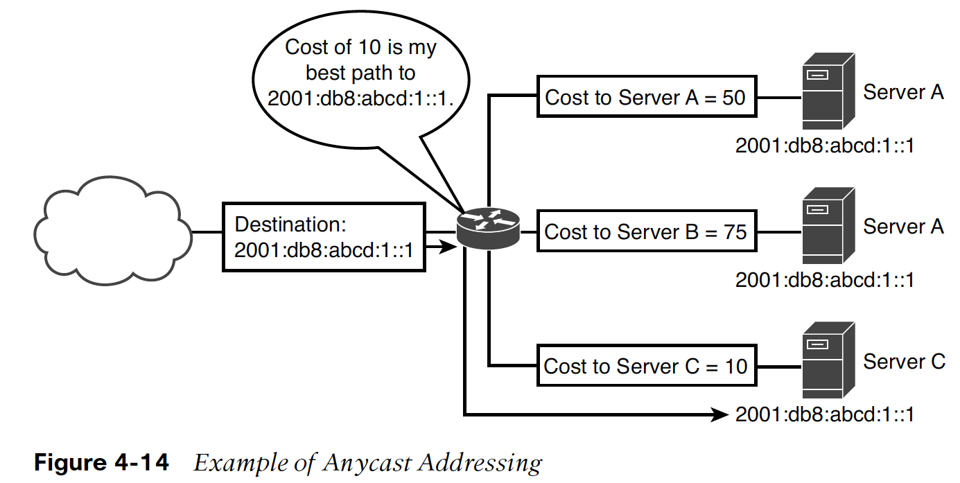

Slide 64
Interface Identifiers
IPv6 requires that every network interface have its own unique identifier
  Hardware vendors tend to use the modified EUI-64 format
  Software makers, including Microsoft, use the privacy format defined in RFC 4941
Having the right-hand portion of your IPv6 address based on the computer’s MAC or hardware address presents a security concern
© 2013 Course Technology/Cengage Learning. All Rights Reserved.

Slide 65
Native IPv6 Addresses in URLs
RFC 2732 (originally proposed in 1999)
  Describes a method to express IPv6 addresses in a form compatible with HTTP URLs
  Uses square brackets ([ and ]), to enclose a literal IPv6 address
Example:
  http://[FEDC:BA98:7654:3210:FEDC:BA98:7654:3210]:70/
© 2013 Course Technology/Cengage Learning. All Rights Reserved.

Slide 66
Address Types
Special addresses
  Unspecified address
    All zeroes and can be represented as two colon characters (::) in normal notation
  Loopback allows a host on a network to check the operation of its own local TCP/IP protocol stack
Multicast addresses
  Used to send an identical message to multiple hosts
Anycast address
  Packets addressed to an anycast address go to the nearest single instance of that address
© 2013 Course Technology/Cengage Learning. All Rights Reserved.

Slide 67
Address Types (cont’d.)
Unicast address
  Sent to one network interface
Aggregatable global unicast address
  Can be combined with other addresses into a single entry in the router table
Link-local address
  First 10 (leftmost) bits set to 1111111010
Site-local address
  First 10 (leftmost) bits set to 1111111011
© 2013 Course Technology/Cengage Learning. All Rights Reserved.

